Slide 1
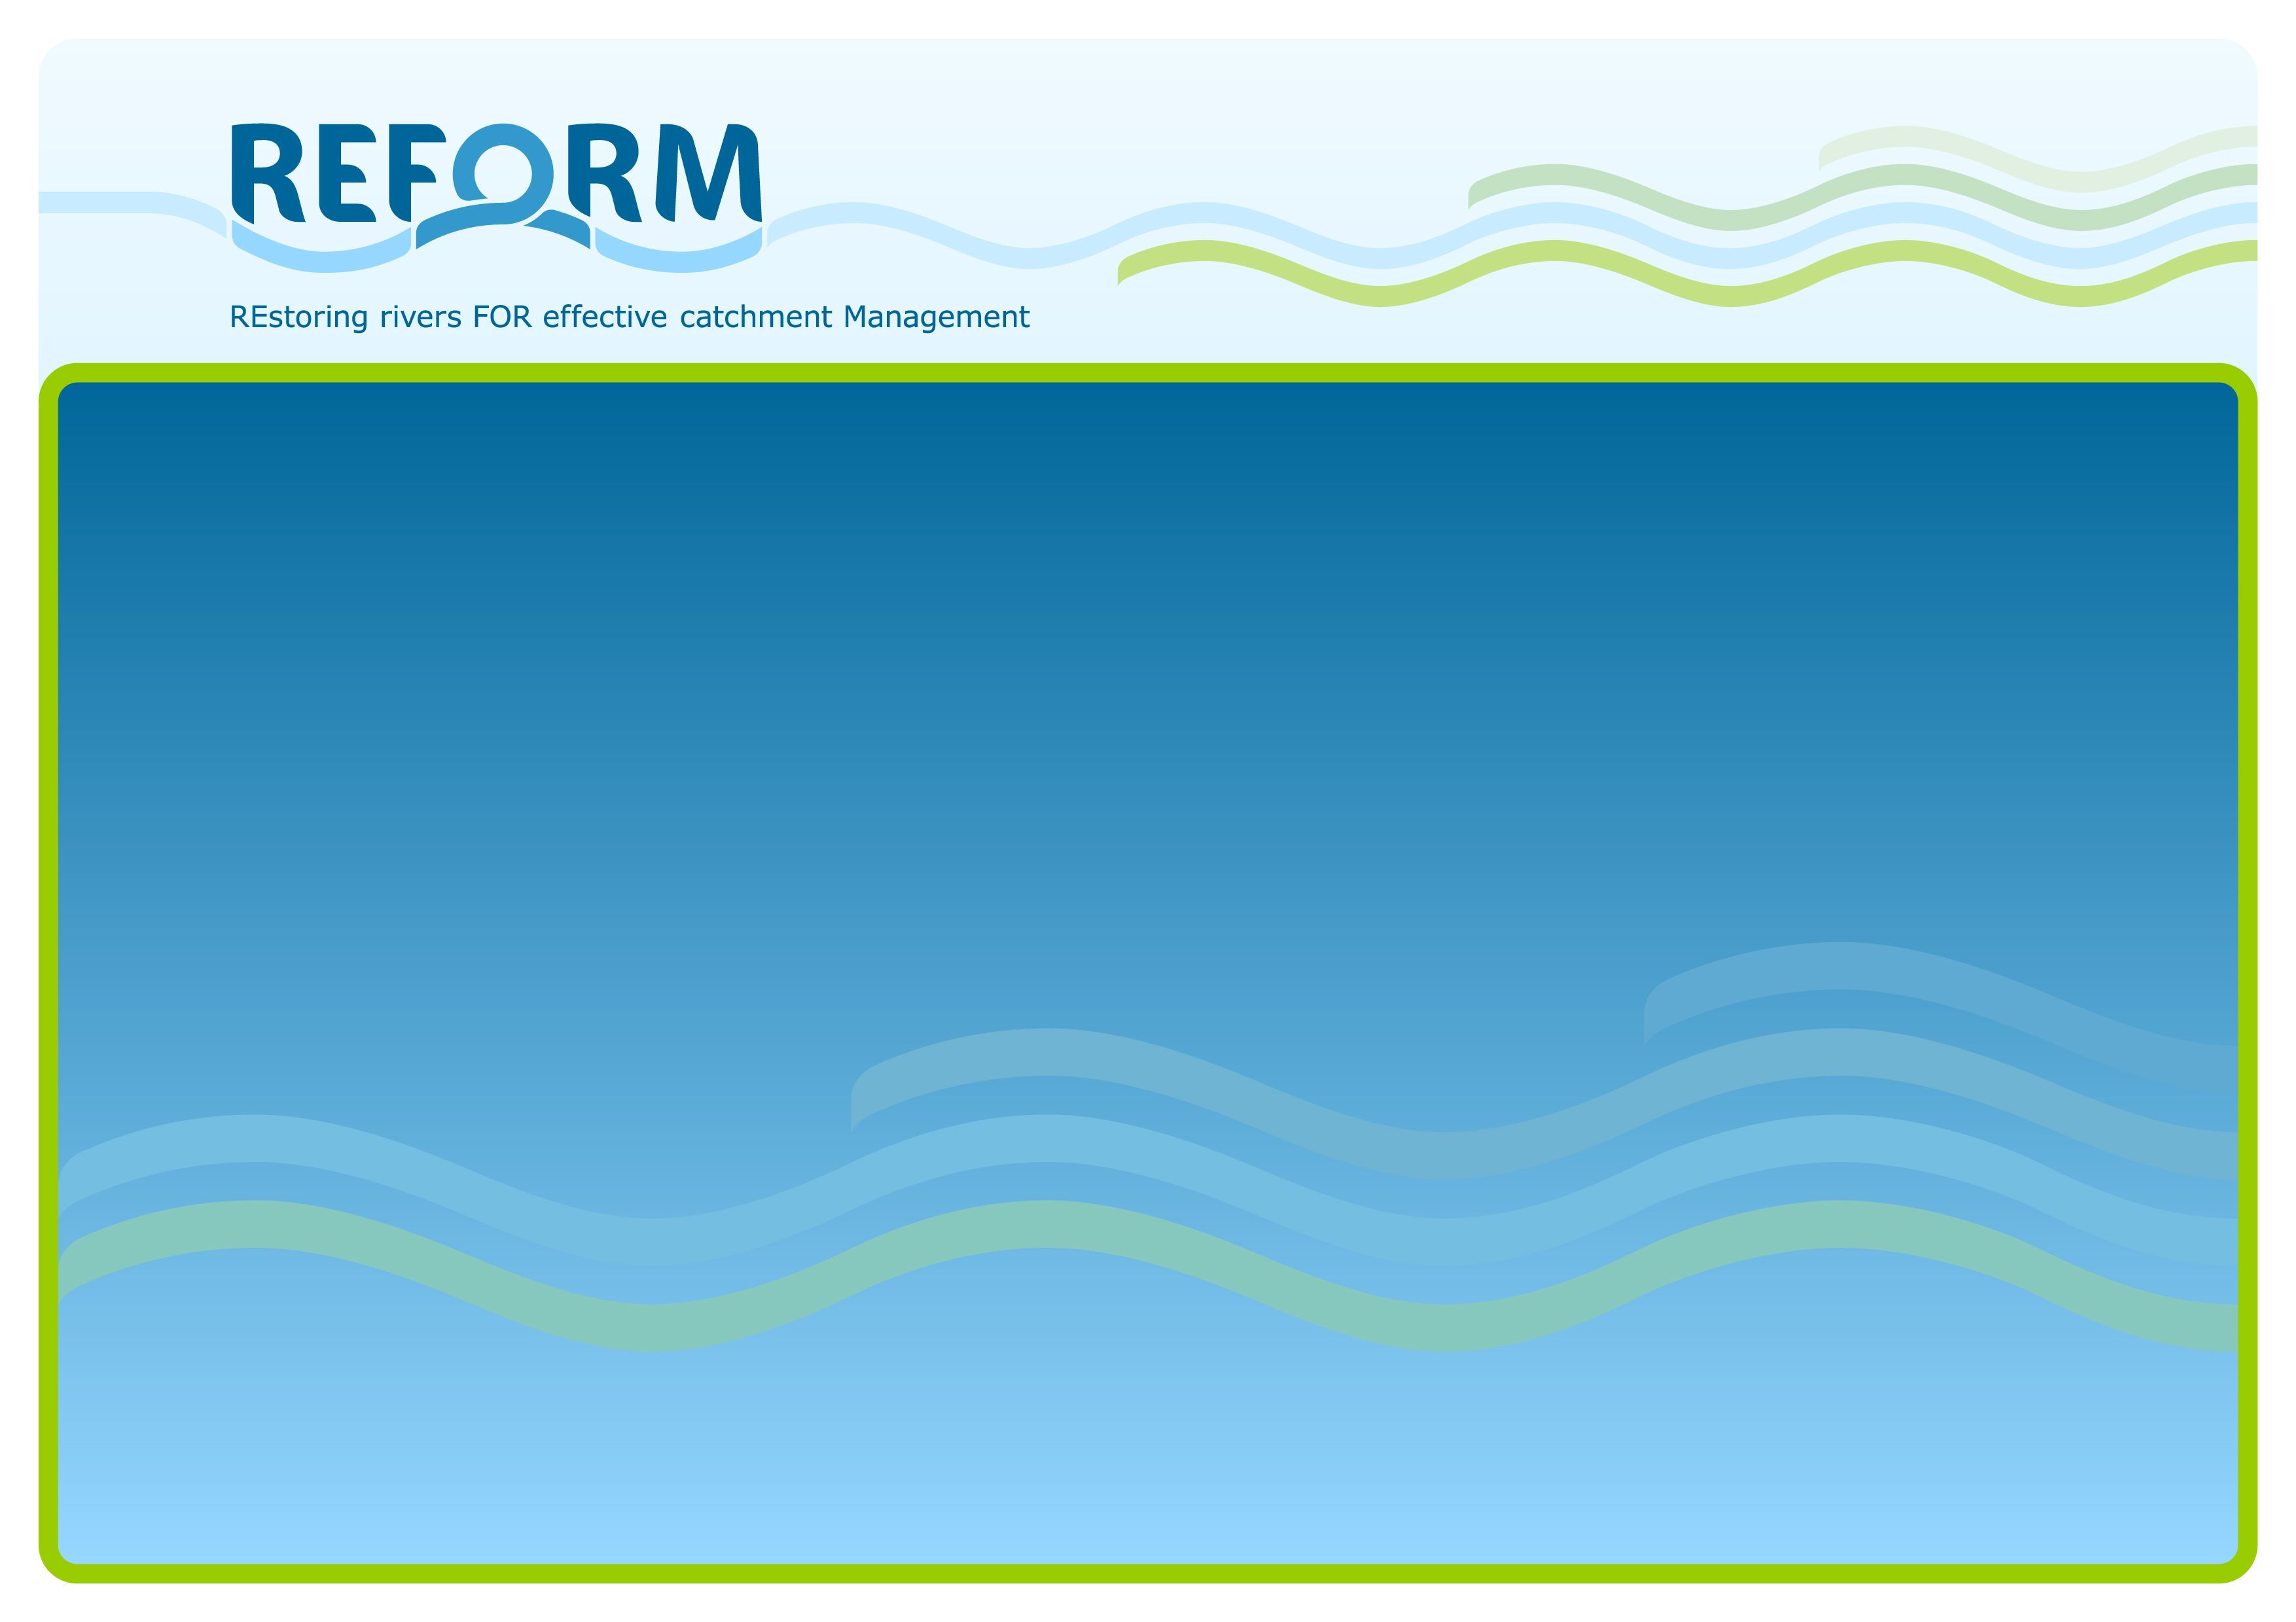

Planning for Restoration success
Ian G. Cowx and Natalie Angelopoulos
HULL INTERNATIONAL FISHERIES INSTITUTE
UNIVERSITY OF HULL
http://www.reformrivers.eu/

Slide 2
Overview
Determining restoration success
  Benchmarking and endpoints
  Project planning approach
Synergies with other sectors to improve outcomes
Project planning and the WIKI
Bank stabilization
Large boulder placement
Reconnected floodplain

Slide 3
Why do we restore rivers? Habitat improvement
Bank stabilization
Log weir
Large boulder placement
Reconnected floodplain

Slide 4
Why do we restore rivers? Improve connectivity
Pool-weir
Nature-like bypass channel
Larinier
Pool - traverse

Slide 5
Occurrence of hydromorphology measures in RBMPs (% of RBMPs)
Source: EEA 2012

Slide 6
Why do we restore rivers?
Reviewed 670+ European projects, 250+ Life/Interreg, [37,000 NA projects]
- few projects establish well defined endpoint criteria
- usually linked to WFD objectives of GES/GP, HD conservation status or local actions [biodiversity improvement, habitat modification etc.]
Rarely quantitative - weaknesses in monitoring or assessment, defining success or outcomes, and often costs and benefit information not available.

Slide 7
How successful are these measures? Defining outcomes
Success rate of 671 European case studies
Source: REFORM D5.1

Slide 8
Measuring success of river restoration actions using end-points and benchmarking
Many practitioners do not follow a systematic approach for planning restoration projects.
Objectives often have not been explicitly formulated.
Many restoration efforts fail or fall short of their objectives, if at all set.
Need project management tools working at river basin scale
Notes:
With an increasing emphasis on river restoration comes a need for new techniques and guidance. Tools are needed to assess stream and watershed condition, to identify factors degrading aquatic habitats, to select appropriate restoration actions, and to monitor and evaluate restoration actions at appropriate scales. Unfortunately, despite the rapid increase in river restoration projects, little is known about the effectiveness of these efforts. Restoration outcomes are often not fully evaluated in terms of success or reasons for success or failure. Workpackage 5.1 of REFORM has gone a long way to addressing some of these needs by developing a protocol for restoration project planning that incorporates benchmarking and setting specific and measurable targets for restoration and mitigation measures. The approach uses project management techniques to solve problems and produce a strategy for the execution of appropriate projects to meet specific environmental and social objectives. It requires knowledge of the technical issues and policy framework and background to conflicts of multiple users of resources and develops a plan for comparison of status with objectives. Such resource planning should become an integral part of the river basin management, and full consultation with all aquatic user groups is essential to promote optimal, sustainable use of the water body whilst meeting WFD targets.
In using this strategy, it is important to recognise that each restoration scheme proposal should be treated individually, as no two situations are alike. It is therefore impossible to provide threshold criteria on which to make decisions. Nevertheless, the decision support tool allows the proposal to be evaluated at different levels and stages and will effectively curtail a proposal at an early stage should the proposal be potentially impractical or unviable.

Slide 9
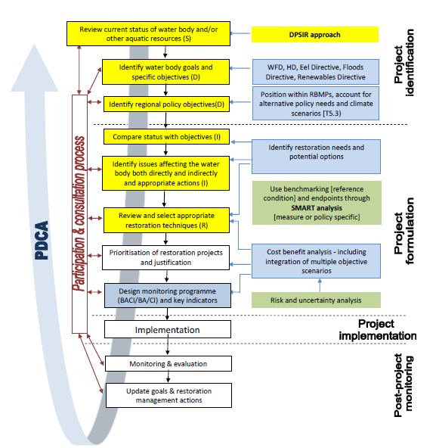
D5.1 Planning protocol
Restoration Planning Approach
It applies various planning tools:
PDCA
Plan, Do, Check, Act
DPSIR (Yellow)
Driver, Pressure, State, Impact, Response
SMART
Specific, Measurable, Attainable,
Relevant,
Time bound.
Source: REFORM D5.1
Notes:
The planning process for river restoration is extremely important if we are to identify river restoration success and improve our rivers.
The functioning of our rivers is complex and therefore the planning in which to restore them is also a complex process.
It has been my task to simplify this framework to make it a more appealing tool that practitioners can actually use, without missing out the key steps needed to identify suitable restoration measures & identify project success.

Slide 10
Restoration Planning Approach
Need to capture risks and uncertainties
Need to consider effectiveness in different river styles
Need to recognise biological responses have long timescales
Need tool that accounts for social ecological coupling ecosystem services)
Need to explore synergies between sectors
REQUIRE TOOL FOR MANAGING EXPECTATIONS AND DESCRIBING MILESTONES AND INCLUDE TIMESCALES

Slide 11
Programme of measures
What is the way forward?
We cannot wait for a complete understanding of river ecosystem before we decide how to target improvement programmes.
Need some type of benchmarking to define objectives
Benchmarking as a tool should be feasible, practical and measureable; the latter especially to help guide future decision support tools.
Questions need to be answered on what needs to be restored, why and how?
This must be coupled within a social and economic framework to meet societal needs and aspirations to address stakeholder/user interactions and conflicts.

Slide 12
Developing benchmarking conditions
Reference sites
Predictive models
Historic
information
Benchmarking
Abiotic habitat
characteristics
Source: Schumtz 2011

Slide 13
Draw on example of the Kissimmee River Restoration
DEFINING SUCCESS: EXPECTATIONS FOR RESTORATION OF THE KISSIMMEE RIVER
Edited by D.H. Anderson, S.G. Bousquin, G.E. Williams, and D.J. Colangelo (2005)

Slide 14
Expectations of the Kissimmee River Restoration
Nine describe abiotic responses for hydrology, geomorphology, and
water quality.
Five expectations describe changes in plant communities in the river channel and floodplain
Six expectations describe invertebrate and amphibian and reptile communities.
Five expectations describe anticipated changes in fish and bird communities.
1 Continuous River Channel Flow
2 Annual Distribution and Year-to-Year Variability of Monthly Mean Flows
3 Stage Hydrograph Characteristics
4 Stage Recession Rates
5 River Channel Velocities
6 River Channel Bed Deposits
7 Sand Deposition and Point Bar Formation Inside River Channel Bends
8 Dissolved Oxygen Concentrations in the River Channel
9 Turbidity and Suspended Solids Concentrations in the River Channel
10 Width of Littoral Vegetation Beds Relative to Channel Pattern
11 Plant Community Structure in the River Channels
12 Areal Coverage of Floodplain Wetlands
13 Areal Coverage of Broadleaf Marsh
14 Areal Coverage of Wet Prairie
15 River Channel Macroinvertebrate Drift Composition
16 Increased Relative Density, Biomass, and Production of Passive Filtering-Collectors on River Channel Snags
17 Aquatic Invertebrate Community Structure in Broadleaf Marshes
18 Aquatic Invertebrate Community Structure in River Channel Benthic Habitats
19 Number of Amphibians and Reptiles Using the Floodplain
20 Use of Floodplain for Amphibian Reproduction and Larval Development
21 Densities of Small Fishes within Floodplain Marshes
22 River Channel Fish Community Structure
23 Guild Composition, Age Classes, and Relative Abundance of Fishes Using
24 Density of Long-Legged Wading Birds on the Floodplain
25 Winter Abundance of Waterfowl on the Floodplain
Source: Anderson et al. 2005

Slide 15
Expectations of the Kissimmee River Restoration
Modify standardized format from Kissimmee: each expectation document contains the following twelve pieces of information
Source: Anderson et al. 2005

Slide 16
Expectations of the Kissimmee River Restoration
Capture risks and uncertainties as new attribute
Social ecological coupling and integration with other drivers incorporated into external constraints
Time course provides milestones where adjustments are made to expectations and expected outcomes

Slide 17
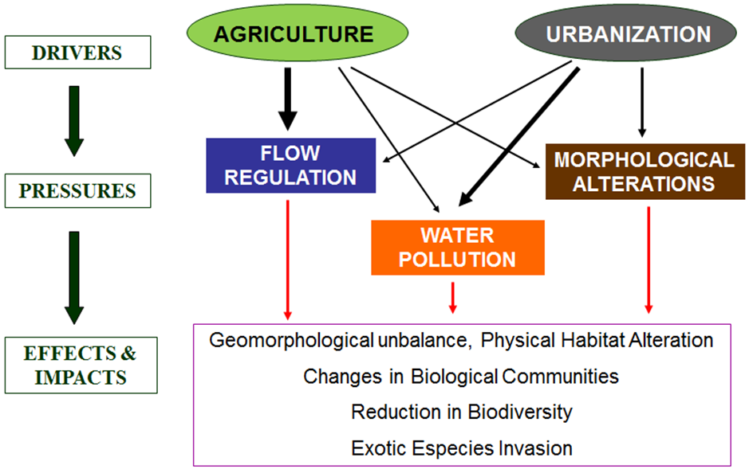
Develop synergies between ecological restoration and ….
Promote current approaches where climate and land use change are taken into account for the choice and design of river restoration practices that promote wider ecosystem and societal benefits

Slide 18
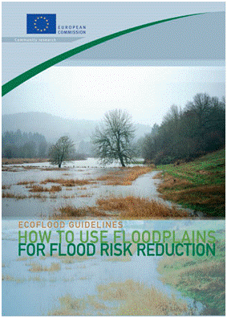
Synergies between ecological restoration and ….
Flood protection (Room for Rivers, Ecoflood)
Navigation (parallel dams; wave action)
Agriculture (land use of riparian zones; sediment dynamics)
Hydropower (Environmental flows; hydropeaking)
Urban development
To …
Expand the potential for restoration
Widen societal accpetance for restoration
Notes:
Work package 5: Restoration potential and strategy

Slide 19
DPSIR approach
Use nested DPSIR approach to assess scope for coupled strategies to incorporate responses to climate [flood protection] and land use [e.g. sedimentation] and renewable energy demands [hydropower] with improvements of ecological status – win-win scenarios.
Nested DPSIR framework for the management of the aquatic environment (source: Atkins et al., 2011a).

Slide 20
DPSIR approach
Structure of inputs related to DPSIR
Drivers - what are the underlying needs and motives of the sectors
Pressures –link to WFD pressures
State – current and future status of pressure status
Impact – what is the impact on BQEs in terms of change in status - how is the hydromorphological state and functioning altered
Response – what measures are adopted to respond to impact -

Slide 21
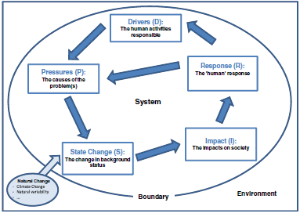
DPSIR approach
Flood Protection
Connect flood plain u/s, to reduce flooding d/s and give opportunity for instream restoration
Channelization
Loss of habitat for fish
Simplification of channel
Atkins et al. 2011
Notes:
Systematic approach that captures the key relationship between society and the environment.
It provides a specific framework for decision making.
Drivers create several or particular pressures on the system, such as navigation causing the pressure channelisation to change the state of the river by reducing its habitat diversity and therefore, impacting on the ecological functioning, the Response could be to restore instream habitat features.
However, this is a simple view of the DPSIR approach, we know there are much more complex relationships between river systems and human demands.
Allowance is also needed for the influence of external natural change.

Slide 22
Example of DPSIR tables – hydropower
DRIVER
Pressures
Hydropeaking
Change to hydrological regime
Impoundments
Channelisation
Construction phase
Turbines
State
Disturbance of flow regime
Altered sediment & transport
Disruption to longitudinal & lateral connectivity
Removal of top soil and vegetation
Mechanical damage
Impact
Loss of habitat diversity and disturbance or normal feeding and growth patterns of aquatic fauna & flora
Restrict or hinder fish migration.
Fish mortality
Delay fish mortality to stress
Response
Improve water discharge regime to mitigate hydropeaking amplitude
Develop environmental flow standards
Install fish pass/ bypass channels
Facilitate d/s migration
HYDROPOWER
Renewable Energy Directive

Slide 23
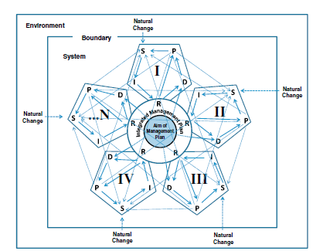
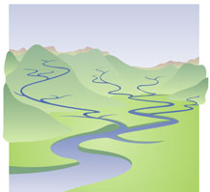
But we work on a complex system.....Nested DPSIR for RBMPs
Unmanaged
pressures
Managed pressures
Notes:
managed pressures – What you can control in a project
Endogenic unmanaged pressures – Possibly out of the area of control, climate change, u/s and d/s impacts, flow regulation, Land use, pollution u/s, industry, invasive species etc….

Slide 24
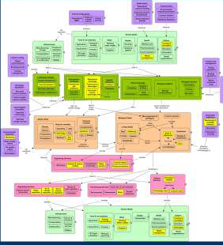
BENEFIT from breaking down DPSIR
Concept maps for managers
Shows how a decision maker or researcher can visualise key concepts related to particular pressures.
To simplify important stages or examples for different pressures & sectors in to concept maps.
Shows how a decision maker or researcher can visualise key concepts related to particular pressures.

Slide 25
DPSIR approach -cross sectoral integration
Multi-criteria decision analysis – allows decision makers to examine situations where different stakeholders have different concepts of what is important and what outcomes they desire.

Slide 26
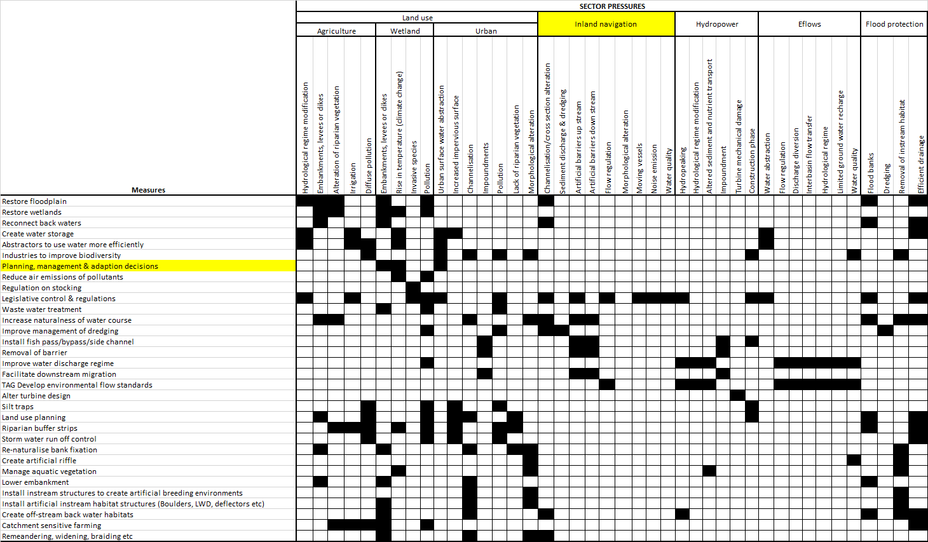
Interaction Matrix for sector pressures and measures (information taken from DPSIR table)

Slide 27
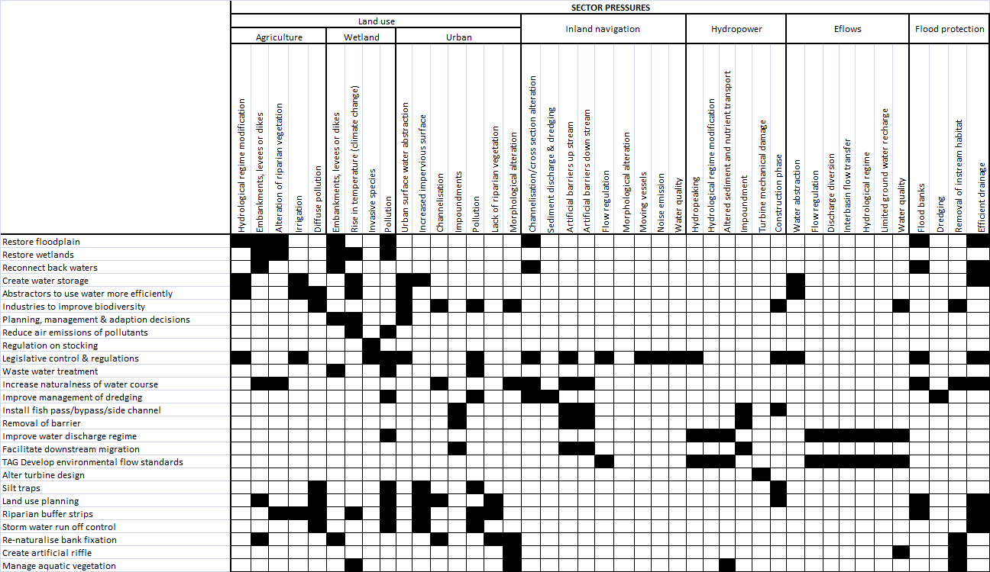
Ideas for Protocol
Decision matrix
Adapt from Leopold
Decision Matrix
Urban
Navigation
Channelisation
SCORE
1-10
Good - bad
P= 9
PRESSURE IMPACT
P= 9
Restore flood plain
FEASIBILIITY OF MEASURE
M= 1
M= 5

Slide 28
Cost Effective Restoration
Use protocol for reporting & predicting cost of river restoration
- economic analysis
- socio-economic cost
- the role of economic assessment in policy: CBA & CEA
- recommend cost typology
2) Requires evidence & practical guidance for cost assessment in river restoration with examples
Problem – acute lack of CBA and CEA analysis so using ecosystem services concept

Slide 29
Integrated planning approach for practitioners
Bite size pieces
Incorporates the PDCA
Feedback loop
User friendly manual
REFORM WIKI
Notes:
A simplified version of the previous framework
The segments clearly show the PDCA cycle.
Each segment, systematically plays a key role in the project planning framework
Feedback loop it turns out not to be technically or economically feasible then back to project evacuation and project identification.

Slide 30
Tools & Guidelines
Tools available on REFORM WIKI
Integrated planning approach
Tools
Notes:
Planning programmes of measures. When measure goals are clear for the river reach, you can enter the planning cycle to start detailed planning of the measures in the reach. This involves interaction with local stakeholders to which you present your assessement of their reach. Toghether you can identify possible measures, formulate the projects, get (co)financing, implement and don’t forget to budget for monitoring!

Slide 31
Project planning cycle
The framework systematically guides practitioners through two main planning stages of river restoration: catchment planning and the project cycle
Notes:
Recap of the catchment planning cycle.

Slide 32
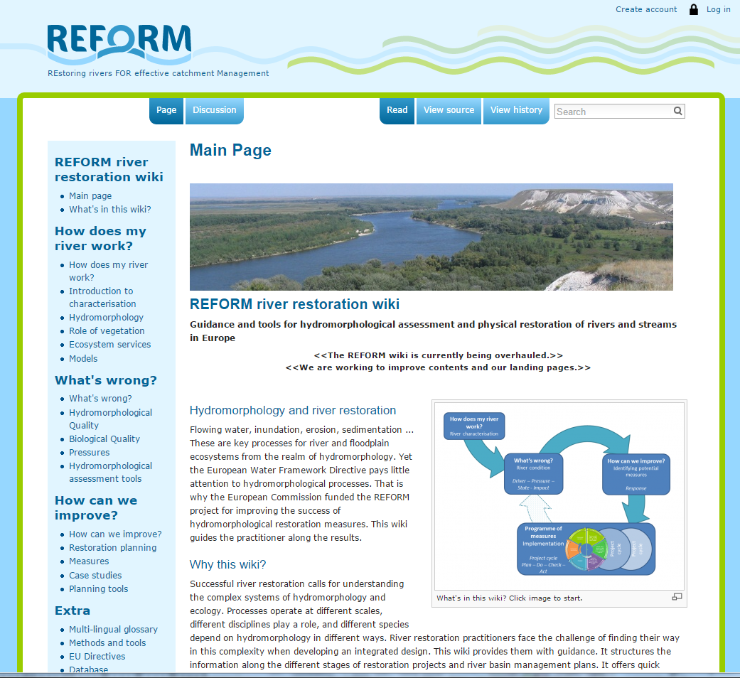
REFORM WIKI
Notes:
wiki.reformrivers.eu
The REFORM wiki is work in progress. It is filled as the deliverables of the REFORM project become available during the period 2012-2015. We are currently working to improve our landing pages for the Wiki.
It is a knowledge management tool to help practitioners reach ecological objectives for river rehabilitation.
The REFORM-wiki contains three main parts: know-how (case studies), knowledge and evaluation (tools) that are all interlinked.
Every listed pressure under Category:Pressures
Every listed restoration measure under Category:Measures
Every tool listed is linked to the WFD Hydro-morphological and WFD Biological quality elements in HYMOQE and BQE.
Case study examples

